Slide 1
Landscape Generation
Project for the course of Deep Learning 2022-2023
Jahrim Gabriele Cesario
jahrim.cesario2@studio.unibo.it
Repository: https://github.com/jahrim/dl-project
Colab: https://colab.research.google.com/drive/1vof-GBruVmq2ZhjEyifVLhNtbRypOBzc?usp=sharing

Slide 2
Business Understanding

Slide 3
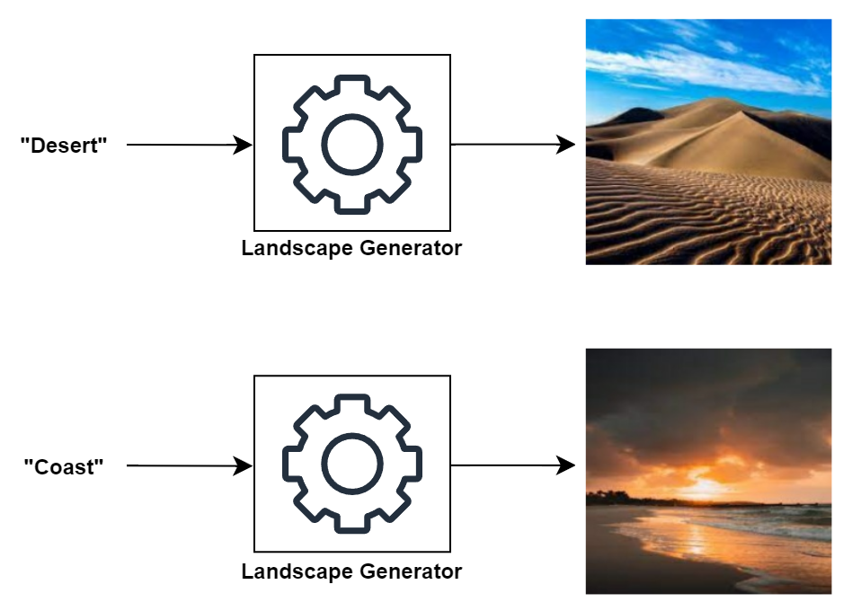
Problem
The goal of this project is to train a generative model capable of creating images representing different kinds of landscapes.

Slide 4
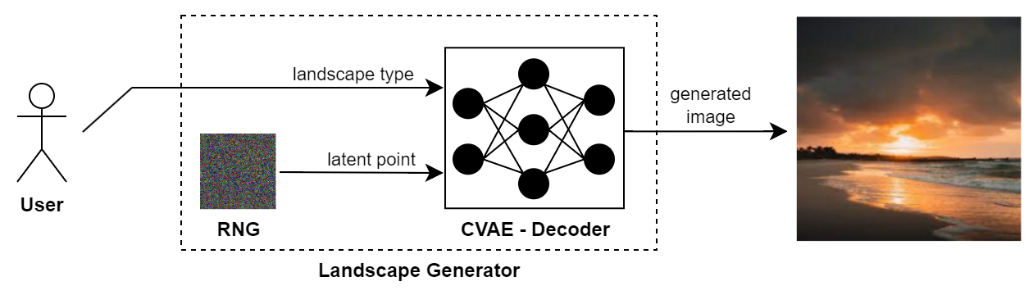
Strategy
To let the user choose the kind of landscape to generate during prediction, the type of generative model trained in this project will be the Decoder of a Conditional Variational AutoEncoder (CVAE).

Slide 5
Data Understanding

Slide 6
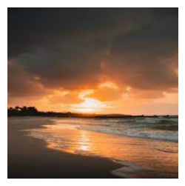
Dataset
The training will be based on the Landscape Recognition Dataset available on Kaggle, which contains 12.000 images of Coasts, Deserts, Forests, Glaciers and Mountains. The dataset is balanced with respect to the landscape types.
Each object of the dataset is a TFRecord containing a 256x256 RGB image bound to a numerical label.
Label Name | Label Id
Coast | 0
Desert | 1
Forest | 2
Glacier | 3
Mountain | 4
256
256

Slide 7
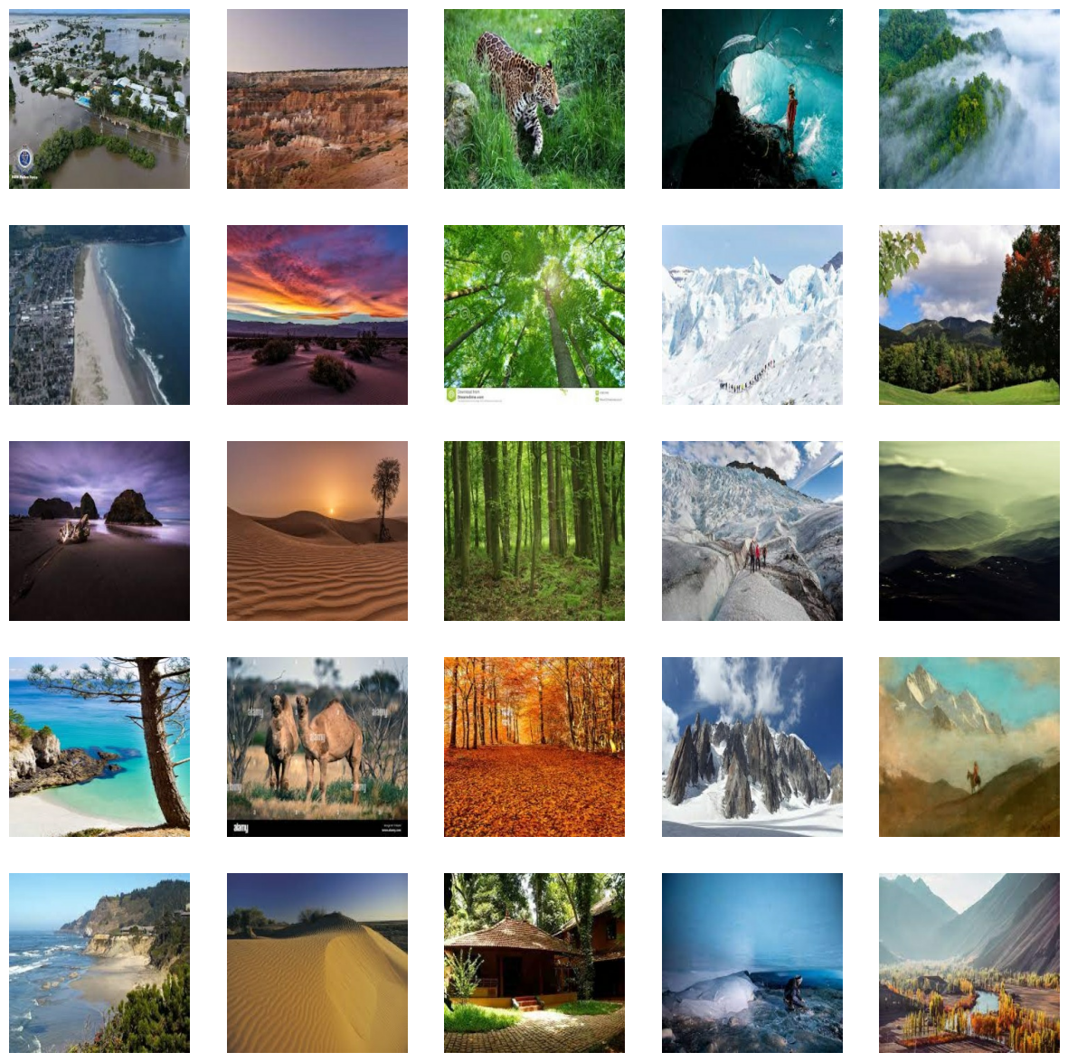
F1. A sample of 25 images extracted from the dataset. Each column contains some pictures of a specific landscape type. In order: Coasts, Deserts, Forests, Glaciers and Mountains (as labelled within the dataset).

Slide 8
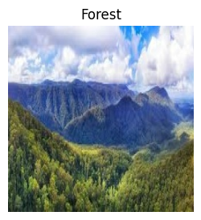
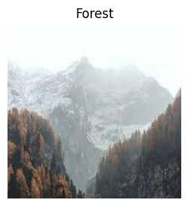
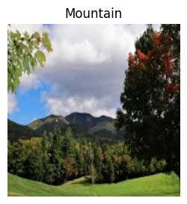
Observations (1/3)
Mixed Landscapes: landscapes are often a mix of different landscape types. The model will have to deal with outliers.

Slide 9
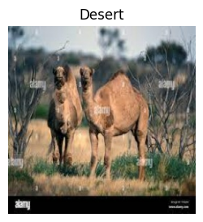
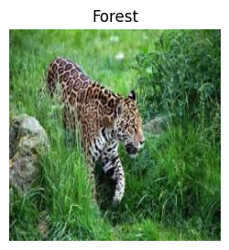
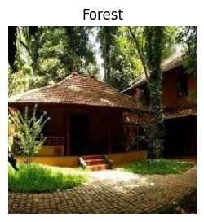
Observations (2/3)
Secondary Subject: landscapes are often a background for the main subjects of the pictures. The model will have to deal with noise.

Slide 10
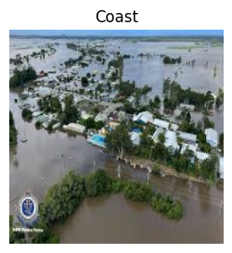
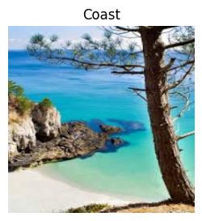
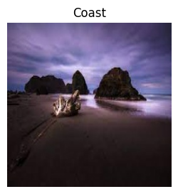
Observations (3/3)
High Variance: each landscape type can be expressed by a large pool of shapes, colors and perspectives. The model will have to learn all these features for each landscape type.

Slide 11
Data Preparation

Slide 12
Parsing
The TFRecords have been parsed to extract the images and labels of the dataset as tensors.
, 0
TFRecord
image: byte[]
label: int64
parsing
256
256

Slide 13
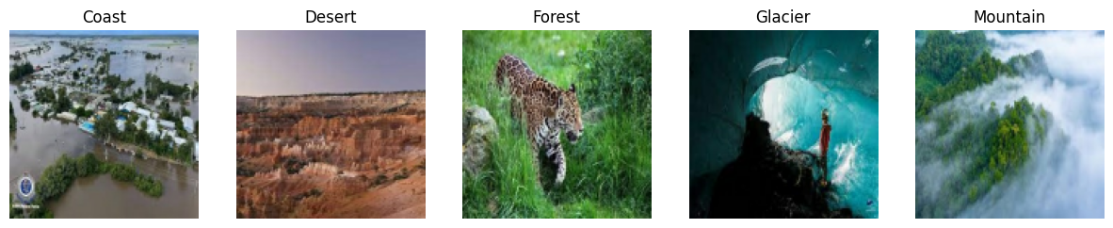
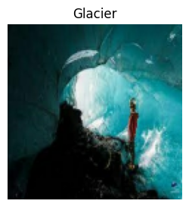
Filtering
In some experiments, the landscape types have been filtered to reduce the variance in the training set, analyzing the performances of the model in different conditions.
only
glaciers

Slide 14
Cropping
The images have been cropped to make sure that they all had the same size.
cropping
256?
256
256?
256

Slide 15
Resizing
In some experiments, the images have also been resized to reduce the complexity of the generation problem.
256
resizing
128
128
256

Slide 16
Normalization
The images have been normalized from values in {0..255} to values in [0; 1] to increase the training stability.
normalization
[1, 0, 0.5, 0.051, …]
[255, 0, 127, 12, …]

Slide 17
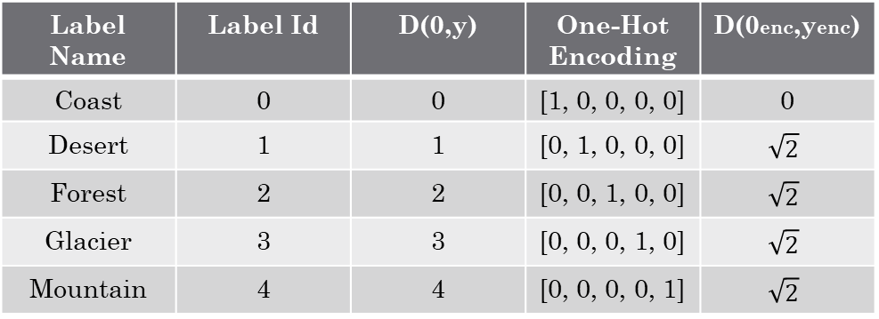
One-Hot Encoding
The labels of the dataset have been transformed using one-hot encoding to forbid the model from inferring similarities between the labels from the similarities between their identifiers.
Label Name | Label Id | D(0,y) | One-Hot Encoding | D(0enc,yenc)
Coast | 0 | 0 | [1, 0, 0, 0, 0] | 0
Desert | 1 | 1 | [0, 1, 0, 0, 0] | $$\sqrt{2}$$
Forest | 2 | 2 | [0, 0, 1, 0, 0] | $$\sqrt{2}$$
Glacier | 3 | 3 | [0, 0, 0, 1, 0] | $$\sqrt{2}$$
Mountain | 4 | 4 | [0, 0, 0, 0, 1] | $$\sqrt{2}$$

Slide 18
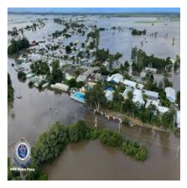
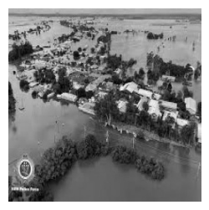
Grayscale Augmentation
In some experiments, the training set has been augmented by transforming the images into grayscale images, with the intention of reducing the amount of focus that the model puts in the colors for distinguishing the different landscape types.
grayscale
augmentation

Slide 19
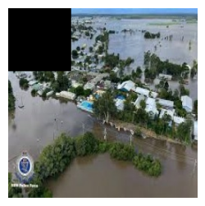
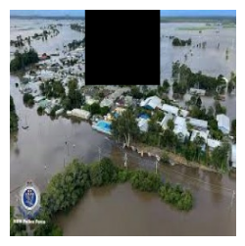
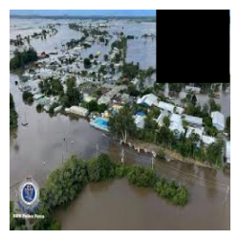
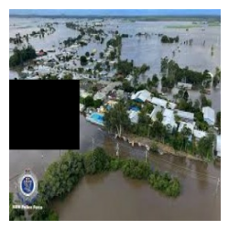
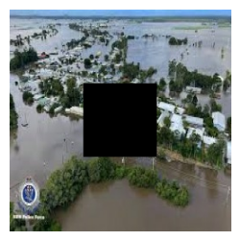
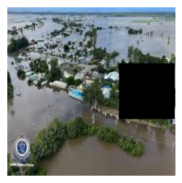
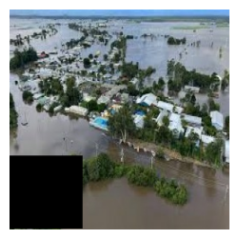
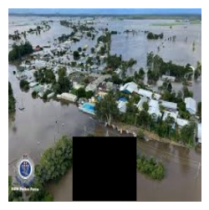
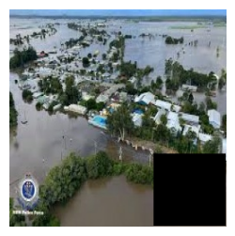
Cut-Out Augmentation
In some experiments, the training set has been augmented by using the Cut-Out method, with the intention of forcing the model to focus on different parts of the images during training.
cut-out
augmentation

Slide 20
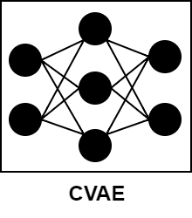
Observations
In retrospective, the effectiveness of the augmentations could have been improved by training the model on different tasks other than reconstructing the original images.
reconstruction
colorization
inpainting
reconstruction

Slide 21
Modelling

Slide 22
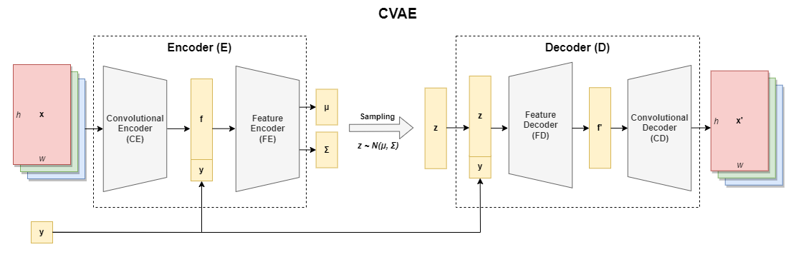
CVAE
In the first experiments, the CVAE included a Convolutional Encoder (Decoder) to map images into features (viceversa) and a Feature Encoder (Decoder) to map such features into points in the latent space (viceversa).

Slide 23
Narrow Variant
CE: deep CNN
FE & FD: deep FFNN
CD: reverse of CE
Features: ~ 1024 - 2048
Weights: ~ 1 - 15M
Example Graph: link

Slide 24
AlexNet Variant
CE: AlexNet with modified outer layers
FE & FD: deep FFNN
CD: reverse of CE
Features: ~ 4096 - 9216
Weights: ~ 120M - 320M
Example Graph: link

Slide 25
Wide Variant
CE: deep CNN, no pooling layers, little compression
FE & FD: simple FFNN, only output layers
CD: reverse of CE
Features: ~ 65536 - 1.048.576
Weights: ~ 10M - 600M
Example Graph:
First version: link
Improved version: link

Slide 26
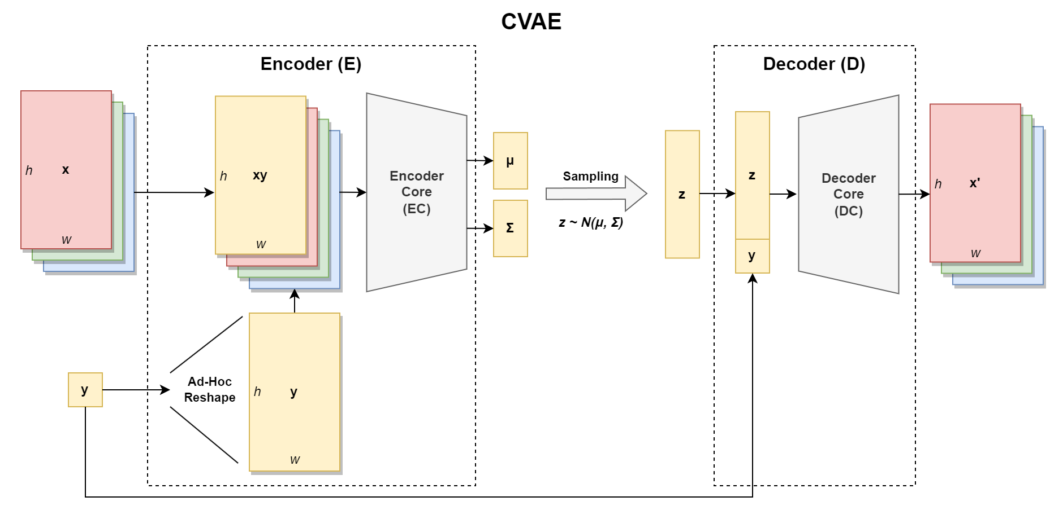
Improved CVAE
In later experiments, the Wide Variant of the CVAE was simplified, including a single component for the Encoder and for the Decoder. Moreover, the features extracted from the images were dependent on the condition.

Slide 27
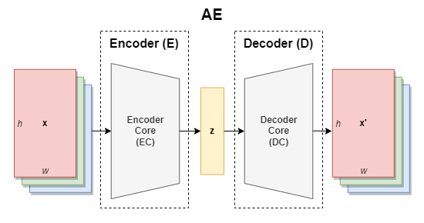
AE
In order to test the reconstruction capabilities of the model, an Undercomplete AutoEncoder with a similar architecture has been trained as well.

Slide 28
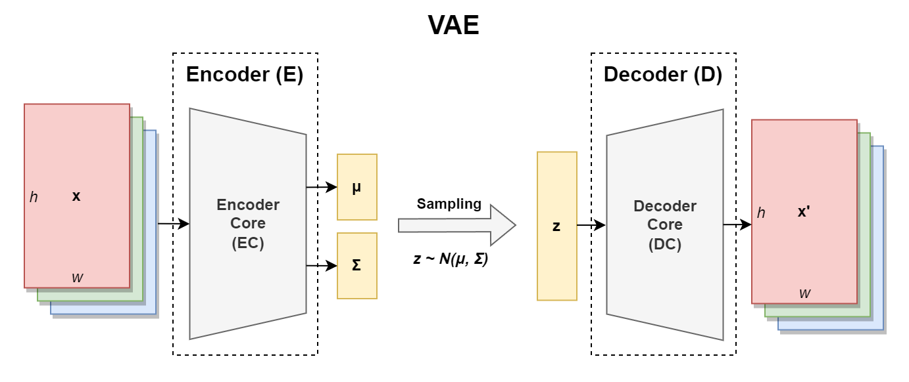
VAE
For further testing involving also the generative capabilities of the model, a Variational AutoEncoder with a similar architecture has been trained as well.

Slide 29
Evaluation

Slide 30
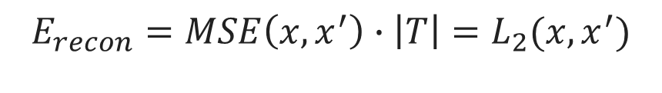
Reconstruction
The first metric used for evaluating the model performance is the Reconstruction Error, which measures how unfaithful the generated images are with respect to the original images.
This was also used for training the model.
$$E_{recon}=MSE\left(x, x^{′}\right)∙\left|T\right|=L_{2}(x, x^{′})$$

Slide 31
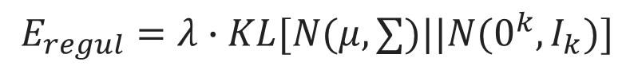
Regularization
The second metric used for evaluating the model performance is the Regularization Error, which measures the degree of incompleteness and discontinuity of the latent space.
This was also used for training the model.
$$E_{regul}=λ∙KL[N(μ,∑)||N(0^{k},I_{k})]$$

Slide 32
Generation Quality
Finally, as the last metric, the quality of the generated images was measured as the accuracy achieved on them by the best landscape classifier for the dataset.
In particular, the quality of the generated images has been evaluated for each landscape type separately.
However, such measure is not complete, as it does not take in consideration the variance of the images generated by the model. Moreover, it is biased towards the features learnt by the landscape classifier.

Slide 33
Results

Slide 34
Performances
Variant | E | F | D | W | T | LA | λ | L | Erecon | Eregul | Qavg
Narrow | 100 | 2048 | 2 | 14M | 1h | linear | 1 | 430 | n/a | n/a | 35%
AlexNet | 100 | 4096 | 4096 | 166M | 1.5h | linear | 1 | 278 | n/a | n/a | 37%
Wide | 100 | 1048576 | 2 | 13M | 2h | tanh | 1 | 481 | 480 | 1 | 44%
Wide | 100 | 1048576 | 10 | 38M | 2h | tanh | 1 | 355 | 349 | 6 | 39%
Wide | 100 | 1048576 | 100 | 321M | 2.5h | tanh | 1 | 207 | 156 | 51 | 36%
Wide + | 100 | 1048576 | 200 | 636M | 4.5h | linear | 0.1 | 57 (291) | 31 | 26 (260) | 28%
Wide + | 100 | 1048576 | 200 | 636M | 3.5h | linear | 1 | 164 | 103 | 61 | 34%
Wide +* | 1000 | 65536 | 1024 | 202M | 9.5h | linear | 1 | 160 | 112 | 48 | 41%
Wide +* | 1000 | 1048576 | 64 | 208M | 22h | linear | 1 | 89 | 42 | 47 | 43%
T1. The performances of some of the best configurations tried for each variant of the model.
E: epochs; F: features; D: code size; W: weights; T: training time; LA: latent activation; L: loss; Qavg: average quality; *: improved wide variant with images resized to 128x128

Slide 35
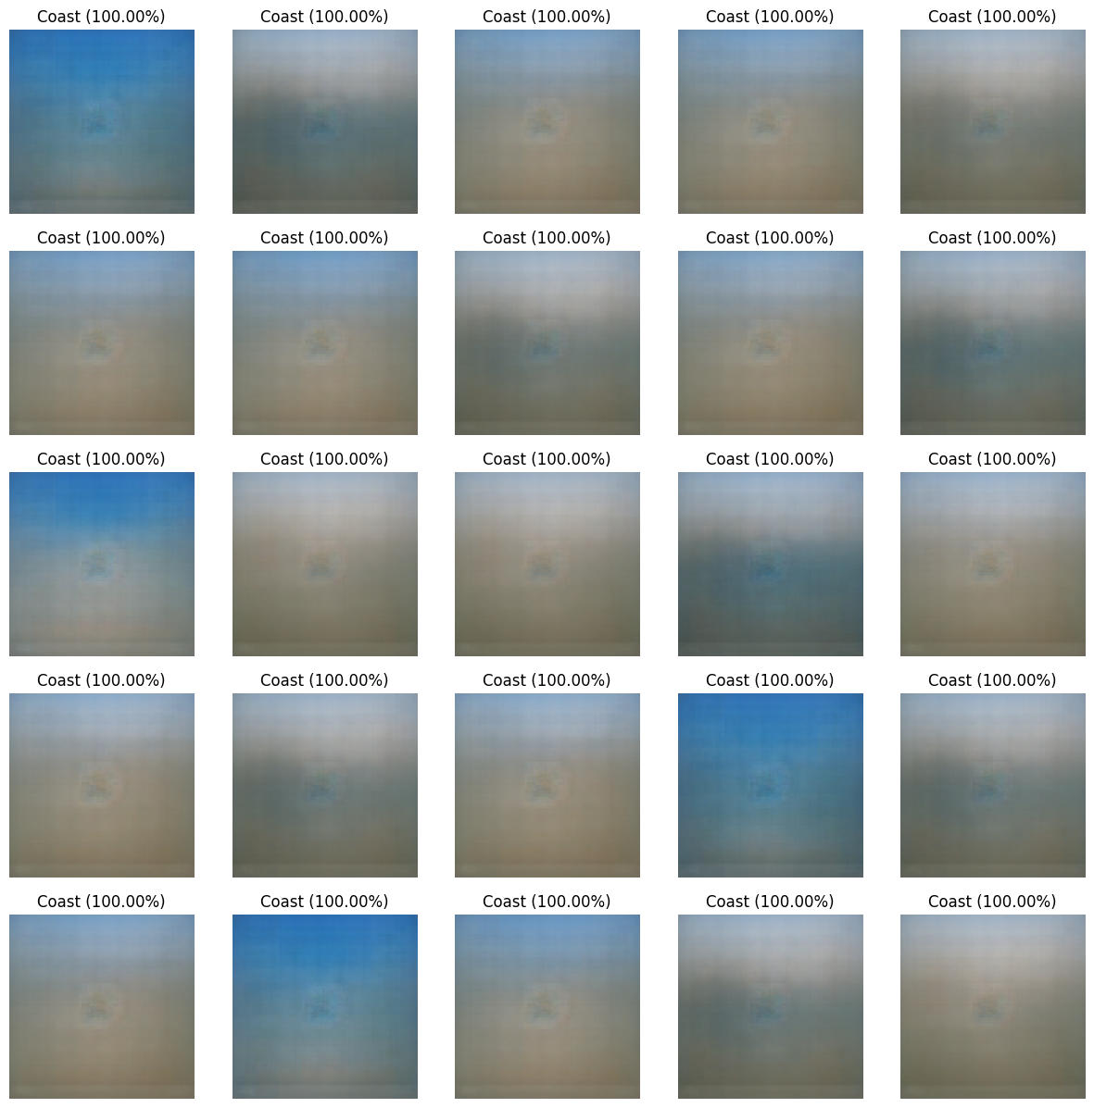
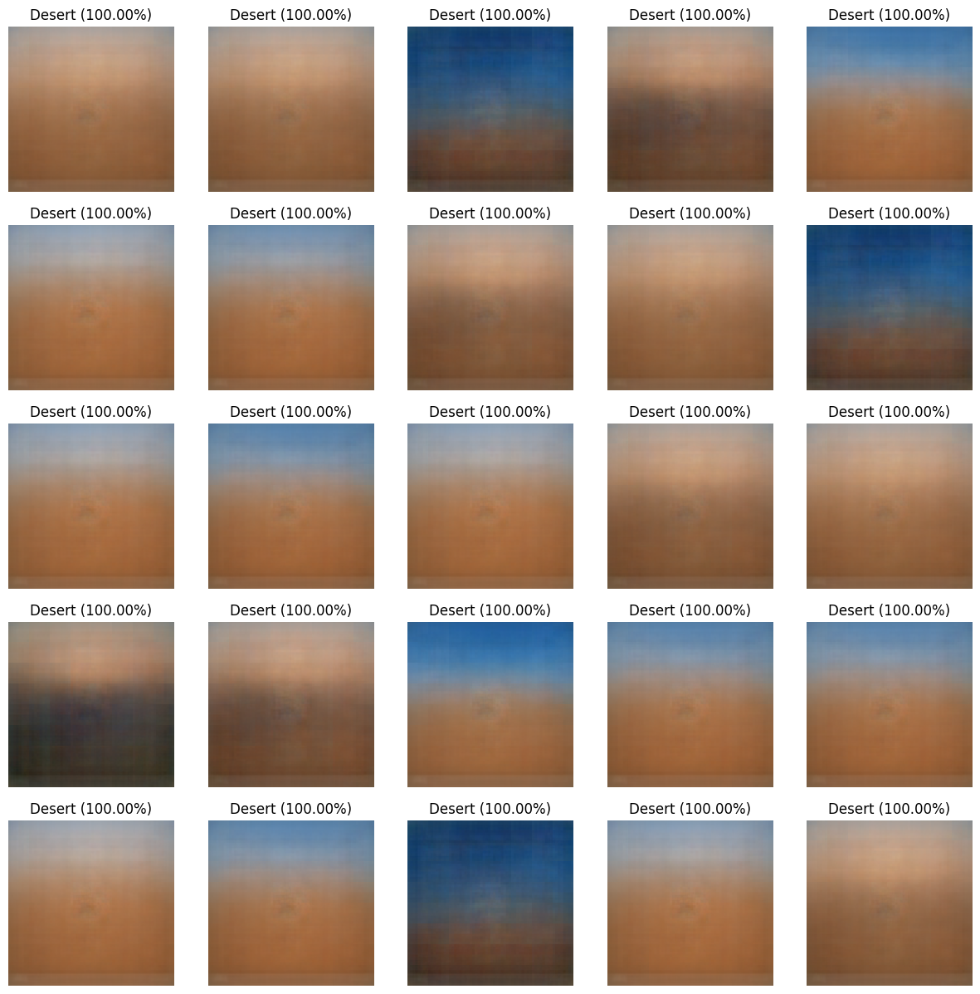
Narrow Variant (1/3)

Slide 36
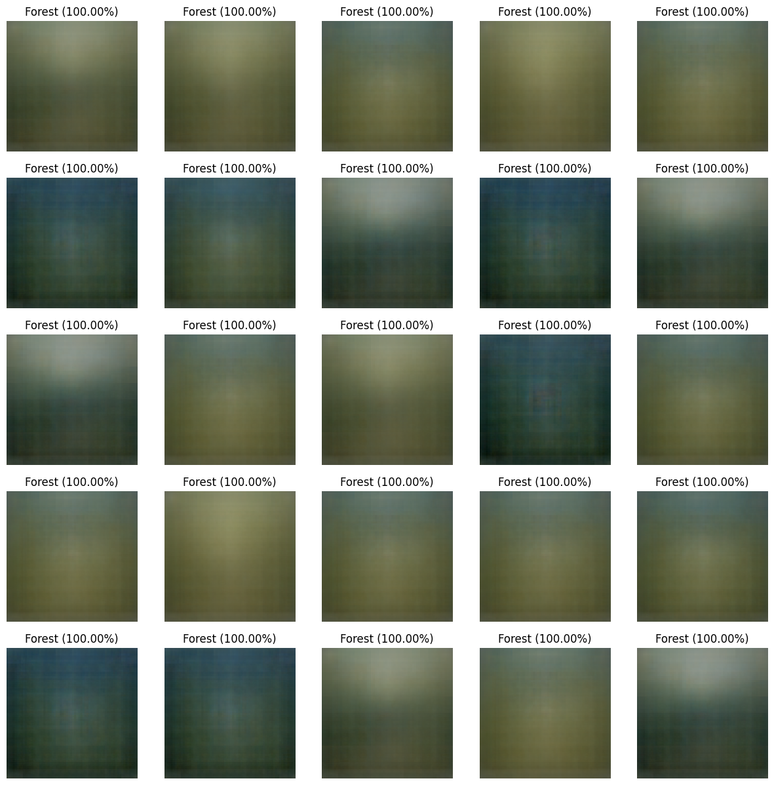
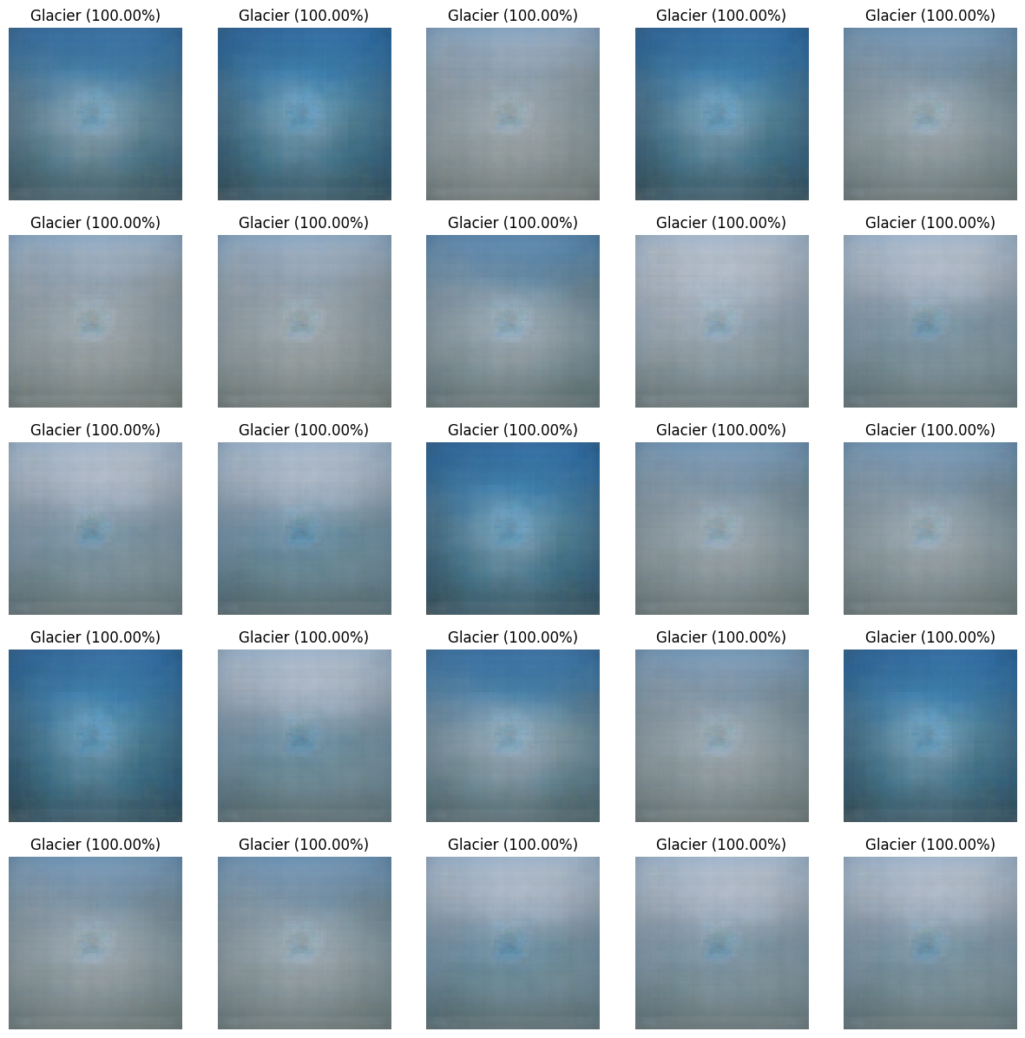
Narrow Variant (2/3)

Slide 37
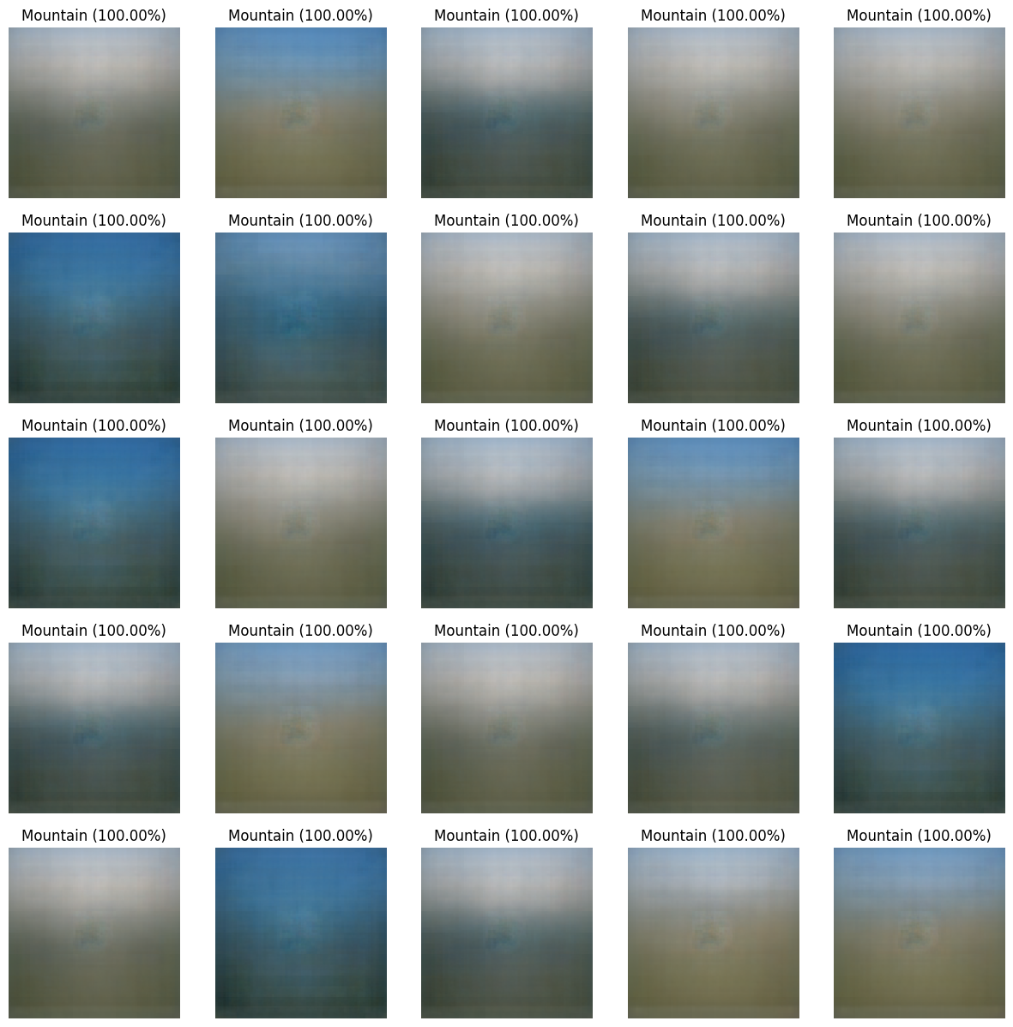
Narrow Variant (3/3)
Landscapes are mostly combinations of colors
Usually there is a terrain and a sky
It can be either day or night

Slide 38
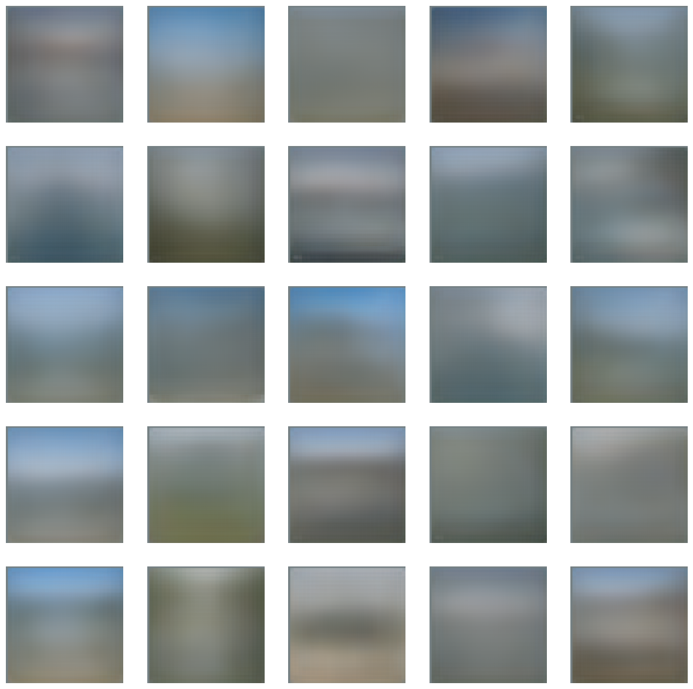
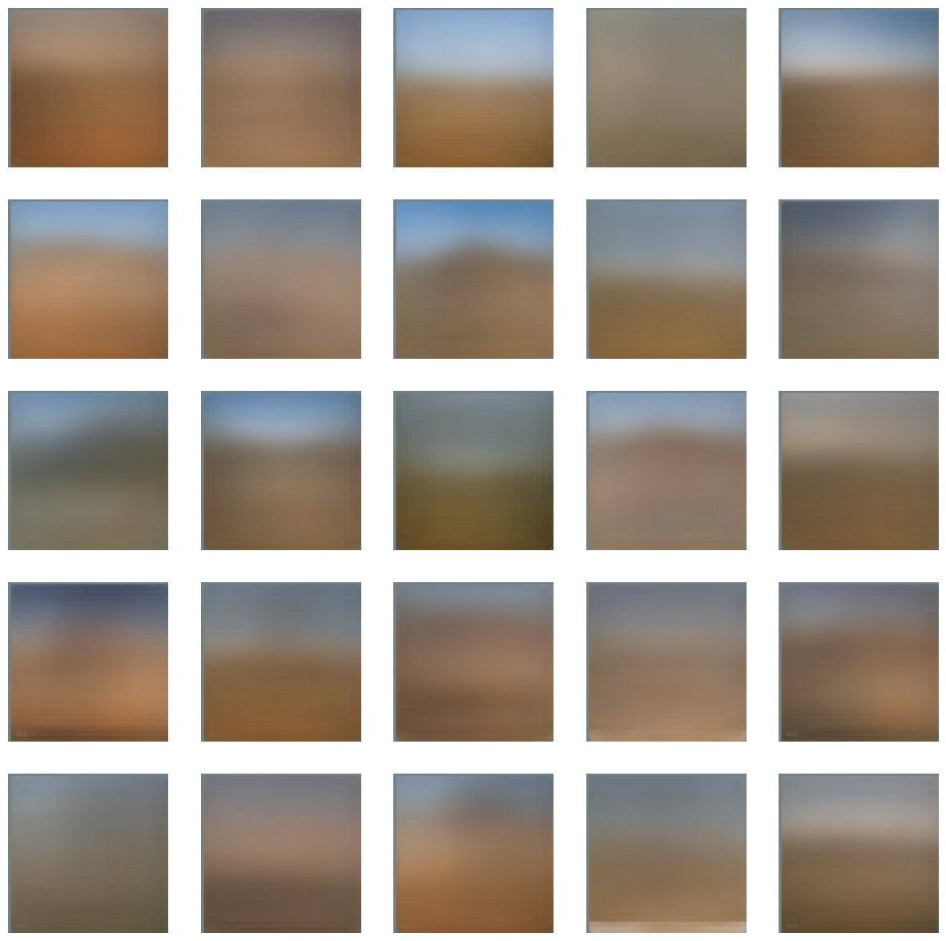
AlexNet Variant (1/3)
coasts
deserts

Slide 39
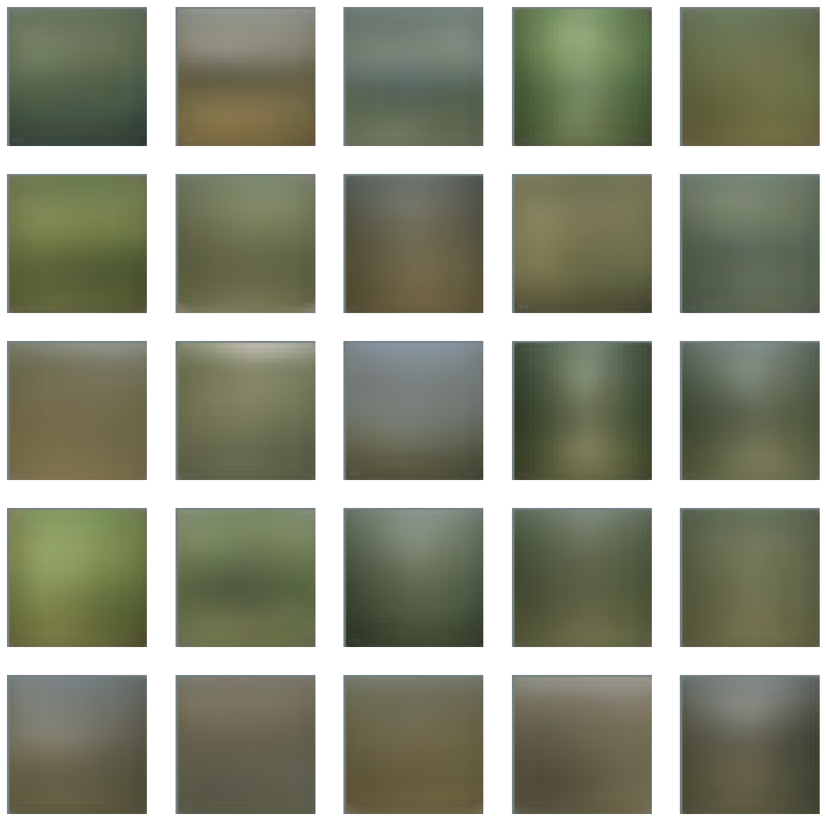
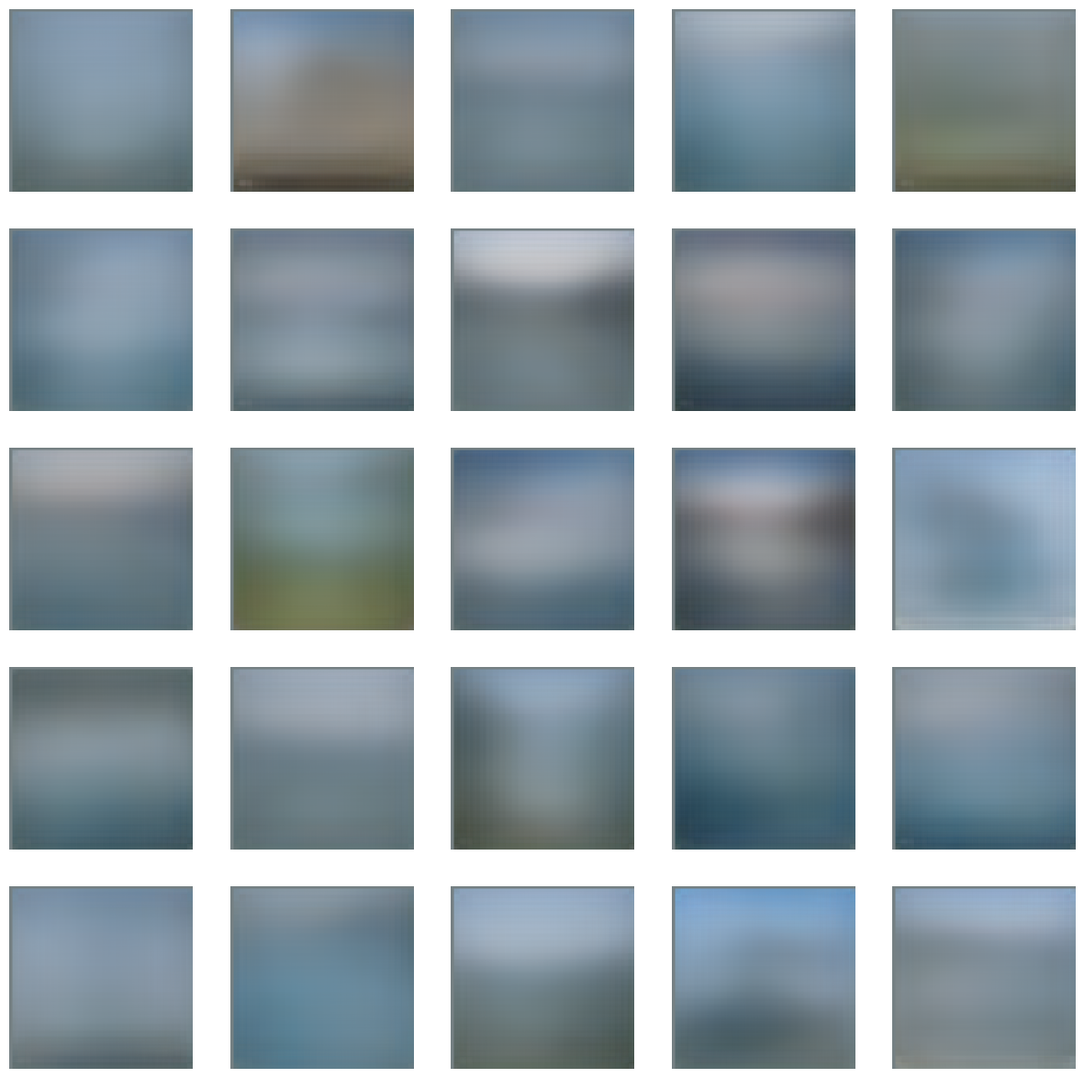
AlexNet Variant (2/3)
forests
glaciers

Slide 40
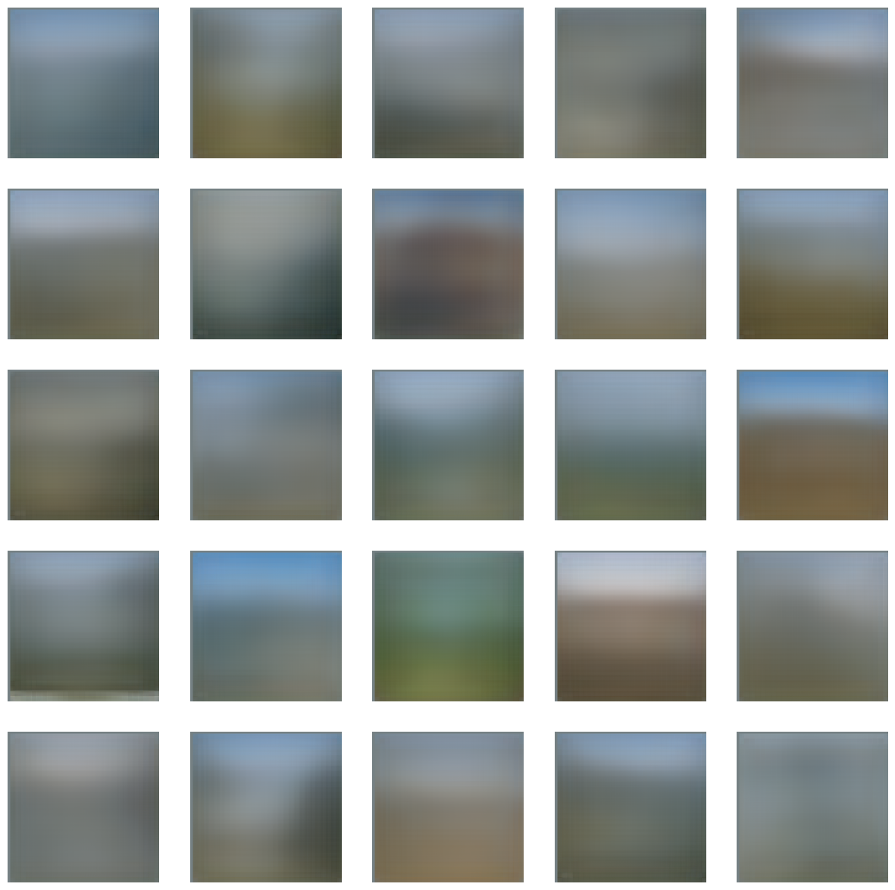
AlexNet Variant (3/3)
Landscapes are also combinations of shapes
Some pictures seem possibly realistic, but very out of focus
mountains

Slide 41
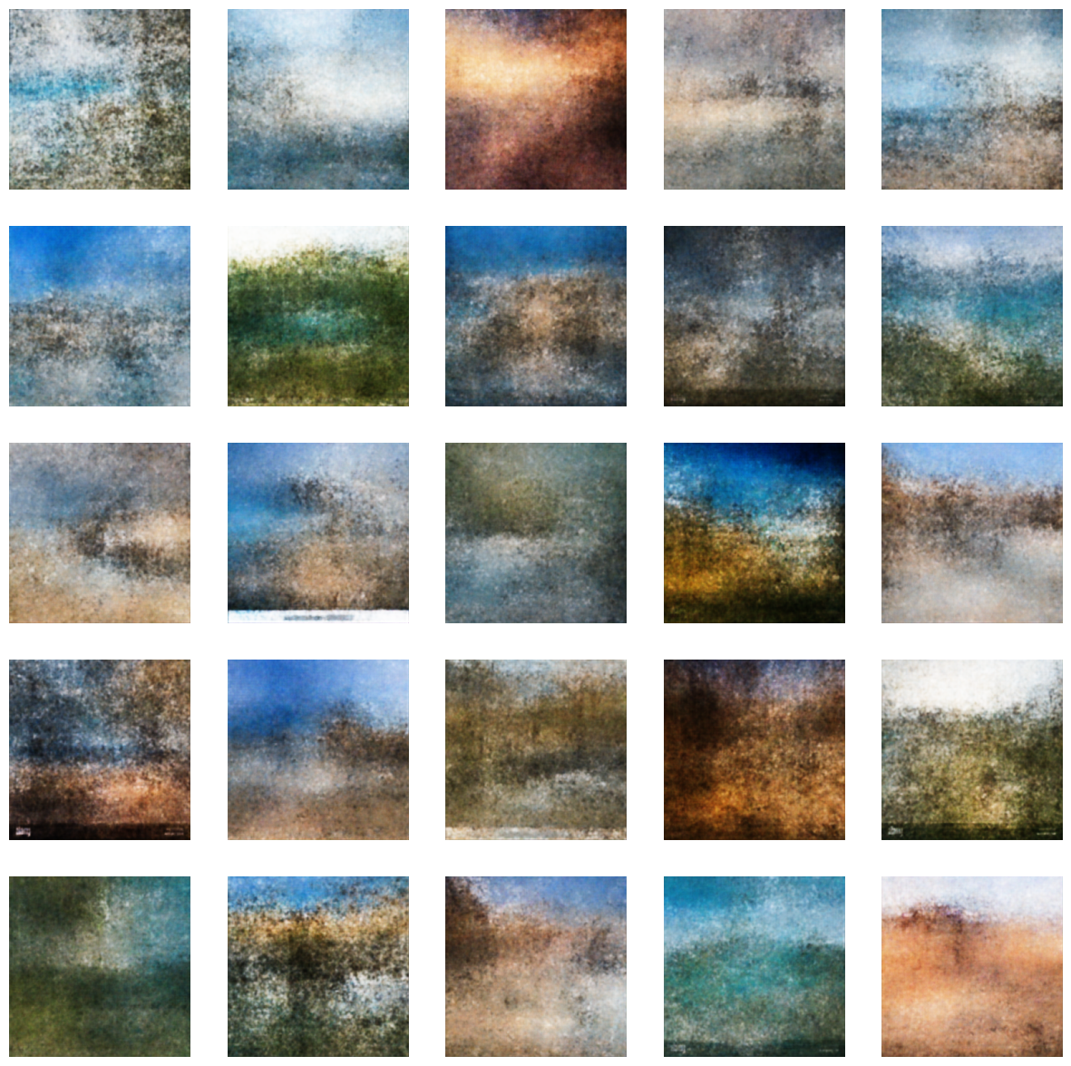
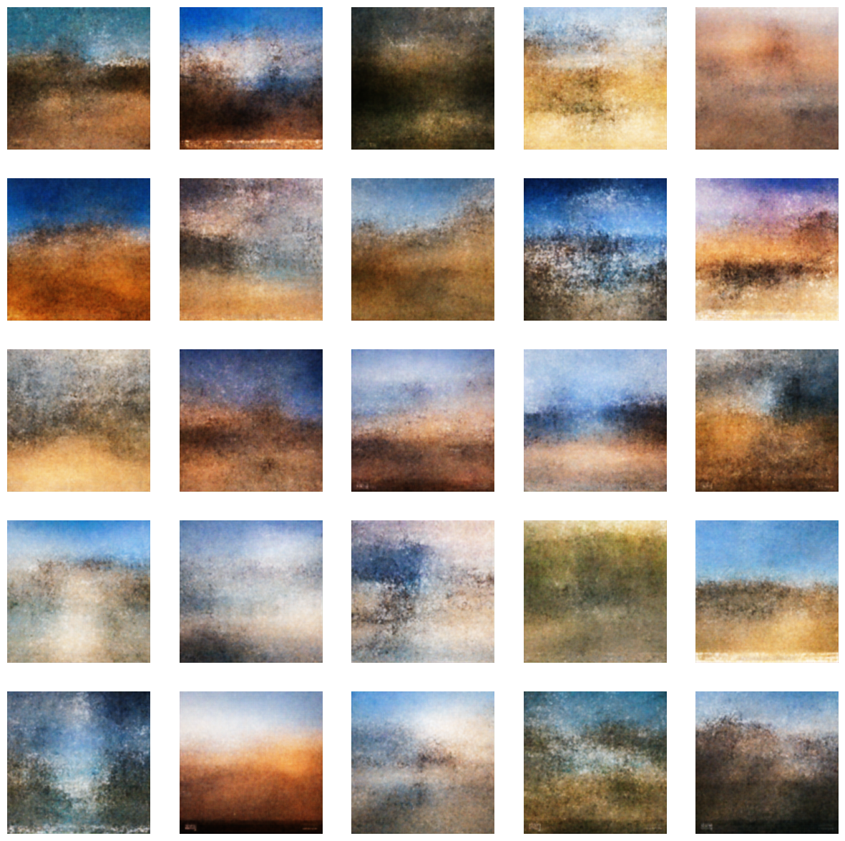
Improved Wide Variant (1/3)
coasts
deserts

Slide 42
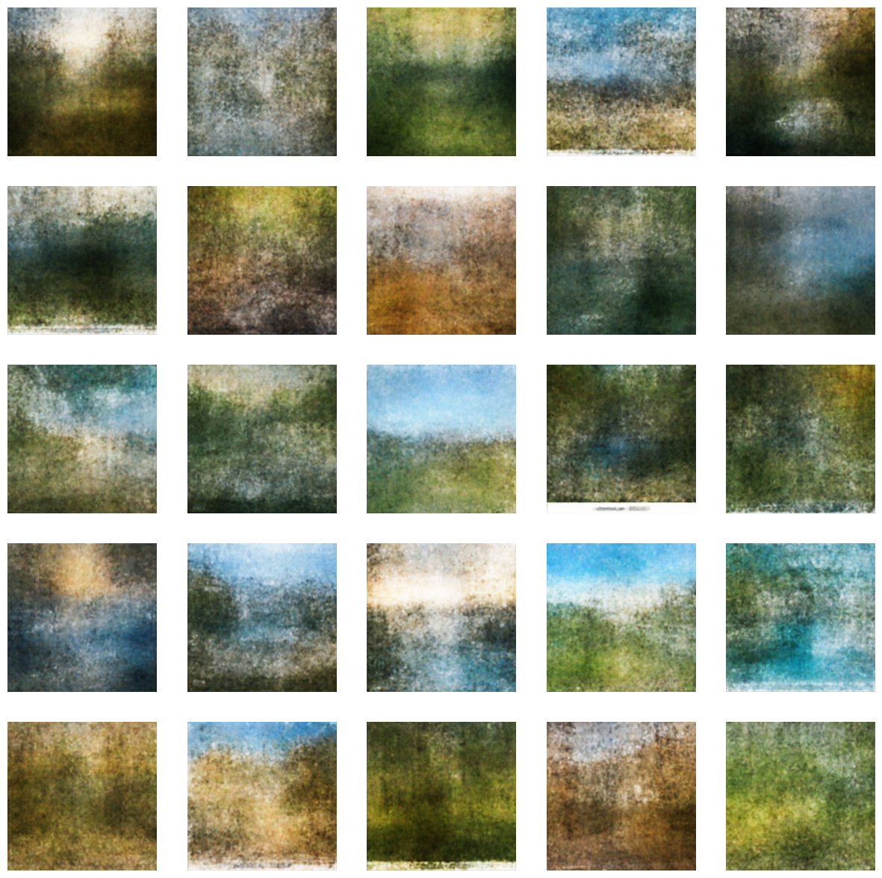
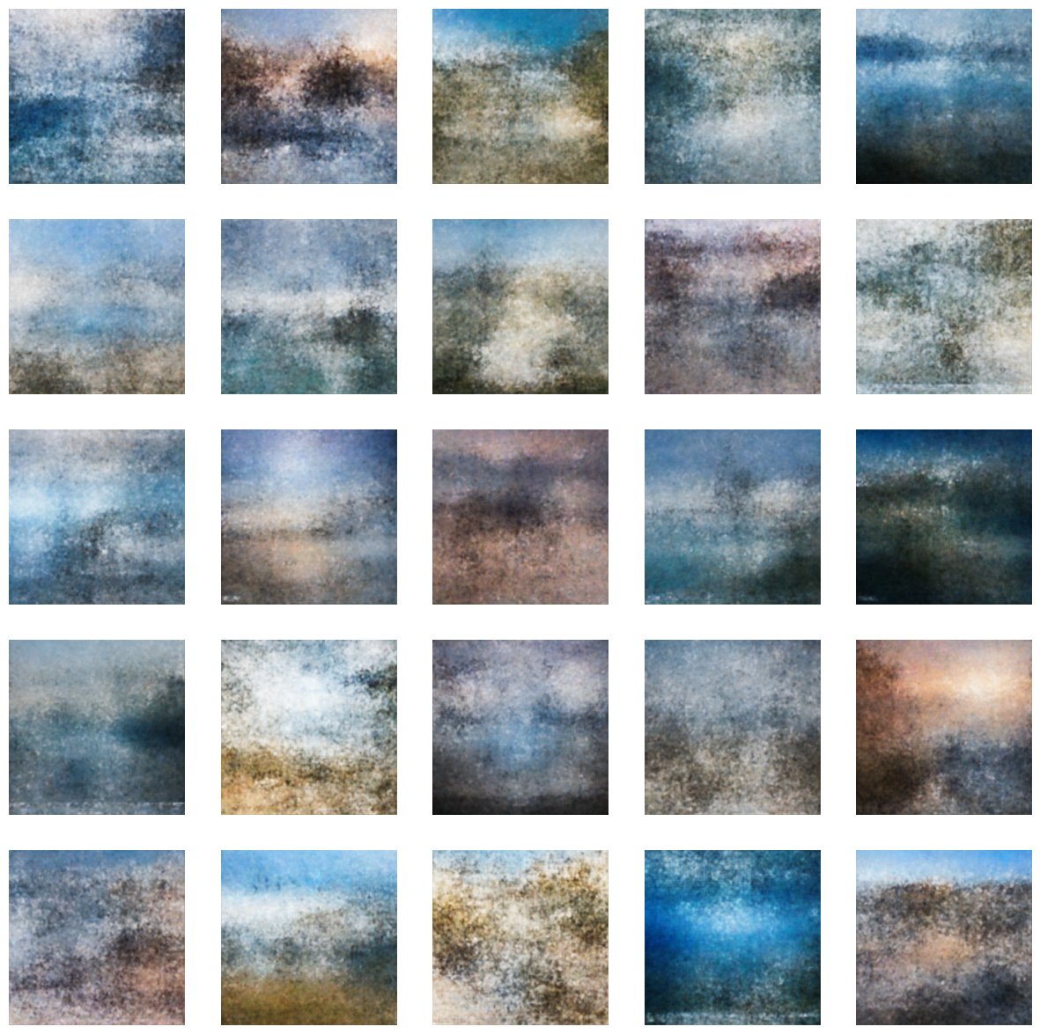
Improved Wide Variant (2/3)
forests
glaciers

Slide 43
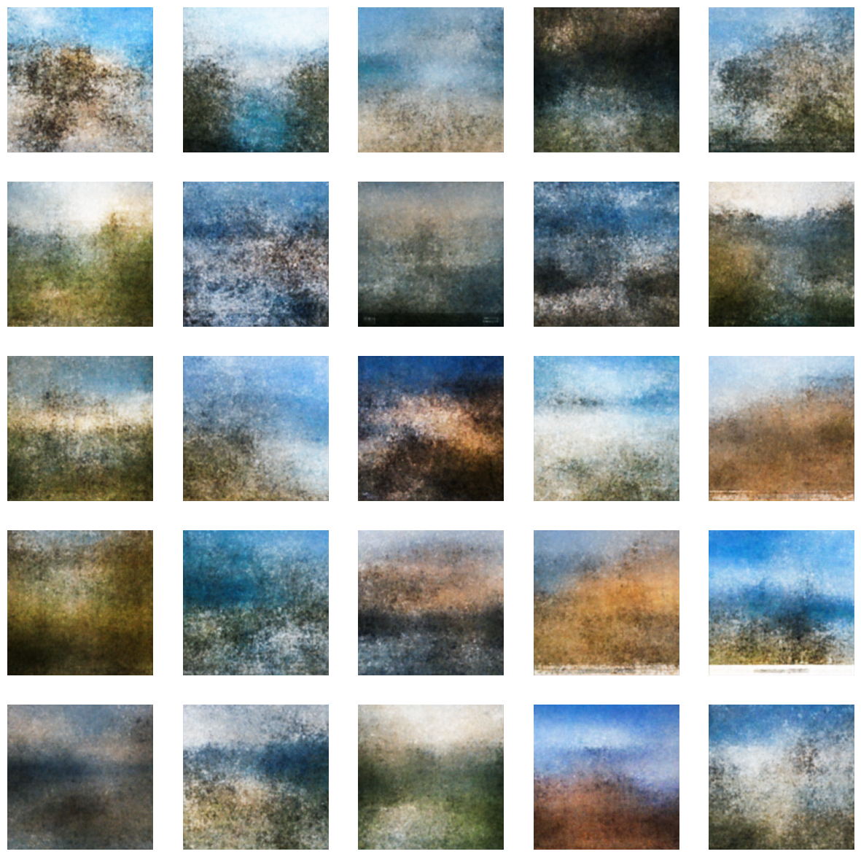
Improved Wide Variant (3/3)
The pictures are no longer out of focus
Some pictures seem like impressionistic representations of landscapes
There’s still lack of details in the images
More outliers in the generated images
mountains

Slide 44
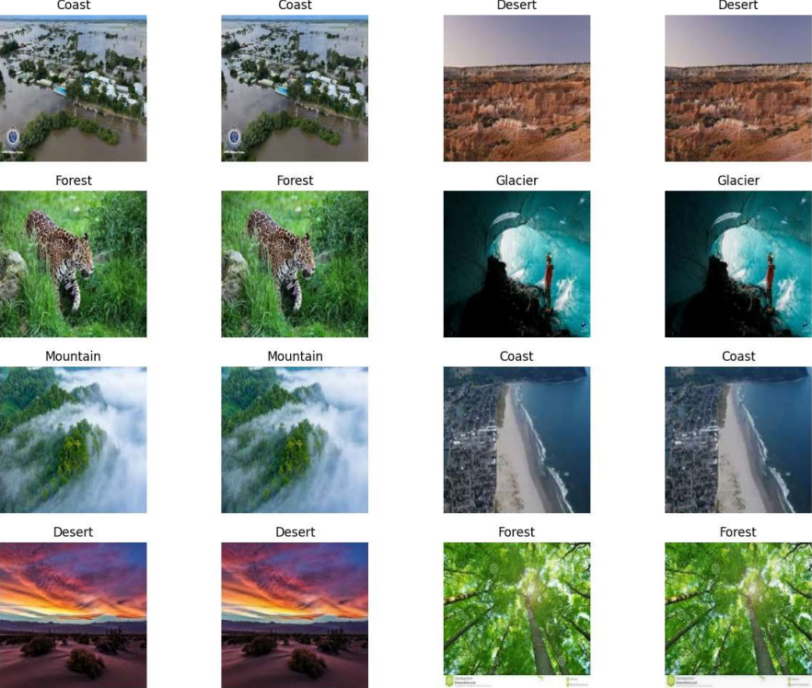
AE
The AutoEncoder could reconstruct the original images flawlessly.
real
generated
real
generated

Slide 45

VAE
The VAE and the CVAE could not reconstruct the original images flawlessly.
real
generated
real
generated

Slide 46




Conclusions (1/4)
Increasing the dimension of the latent space increases the amount of details in the images, up to a certain limit. However, it also increases the amount of outliers in the generated images;
D=2
D=10
D=100
D=200
deserts

Slide 47




Conclusions (2/4)
Increasing the number of features extracted from the original images increases the amount of details in the generated images, up to a certain limit;
reconstruction
F=65536 D=1024 F·D=67108864
reconstruction
F=1048576 D=64 F·D=67108864

Slide 48


Conclusions (3/4)
Decreasing λ increases the quality of the generated images, however it also increases the amount of outliers in the generated images;
high-quality
mountain
outlier
mountain

Slide 49

Conclusions (4/4)
Reducing the size of the images increases the reconstruction performances of the model, but it doesn’t increase the amount of details in the generated images.
coasts
128x128

Slide 50
Further Explorations
The amount of information contained in the condition of the CVAE may be too little, making the task of generating a landscape much more difficult (e.g. to reduce the impact of mixed landscapes, it may be possible to adopt fuzzy labels…);
It may be too difficult to find an explicit distribution that well represents the variety of landscapes in this dataset. The results of this project should be compared with the result obtained with an implicit generative model (e.g. GAN…);
More time could be invested to experiment with more advanced auto-encoding techniques (e.g. skip connections…).

Slide 51
Thank you.

Slide 52
End

